Slide 1
Protein Secondary Structure Prediction Based on Position-Specific Scoring Matrices
J. Mol. Biol. (1999) 292, pages 195-202
David T. Jones
Presenter: Jun-Shong Lin
Date: Nov. 30, 2006

Slide 2
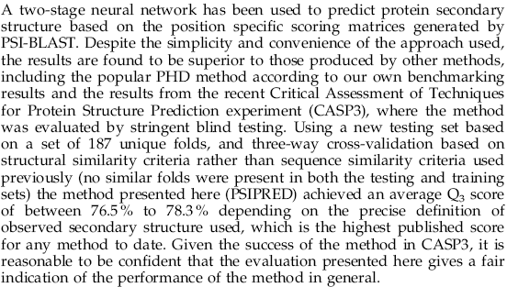
Abstract

Slide 3
Introduction
Increasingly, however, rather than a single sequence a whole family of related sequences is available for analysis.
By constructing a multiple sequence alignment, additional information may be obtained from the observed patterns in sequence variability, and the location of insertions and deletions.

Slide 4
Method
Generation of a sequence profile.
-use PSI-BLAST.
Prediction of initial secondary structure.
-use Neural Networks.
Filtering of the predicted structure.
-use Neural Networks.
  For example, an output of hhhhehhhh might be converted to hhhhhhhhh.

Slide 5
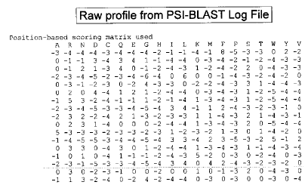
Method
Generation of a sequence profile.
PSI-BLAST
Alignments which incorporate sequences with significant yet low sequence similarity to the target protein produce more accurate predictions that those which incorporate sequences which are very closely related to the target.
Multiple Alignment
Query sequence
Database

Slide 6

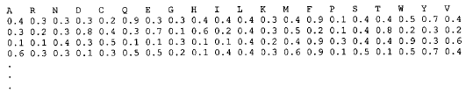
Method
This matrix has 20 x M elements, where M is the length of the target sequence, and each element represents the log-likelihood of that particular residue substitution at that position in the template (based on a weighted average of BLOSUM62 matrix scores for the given alignment position).

Slide 7
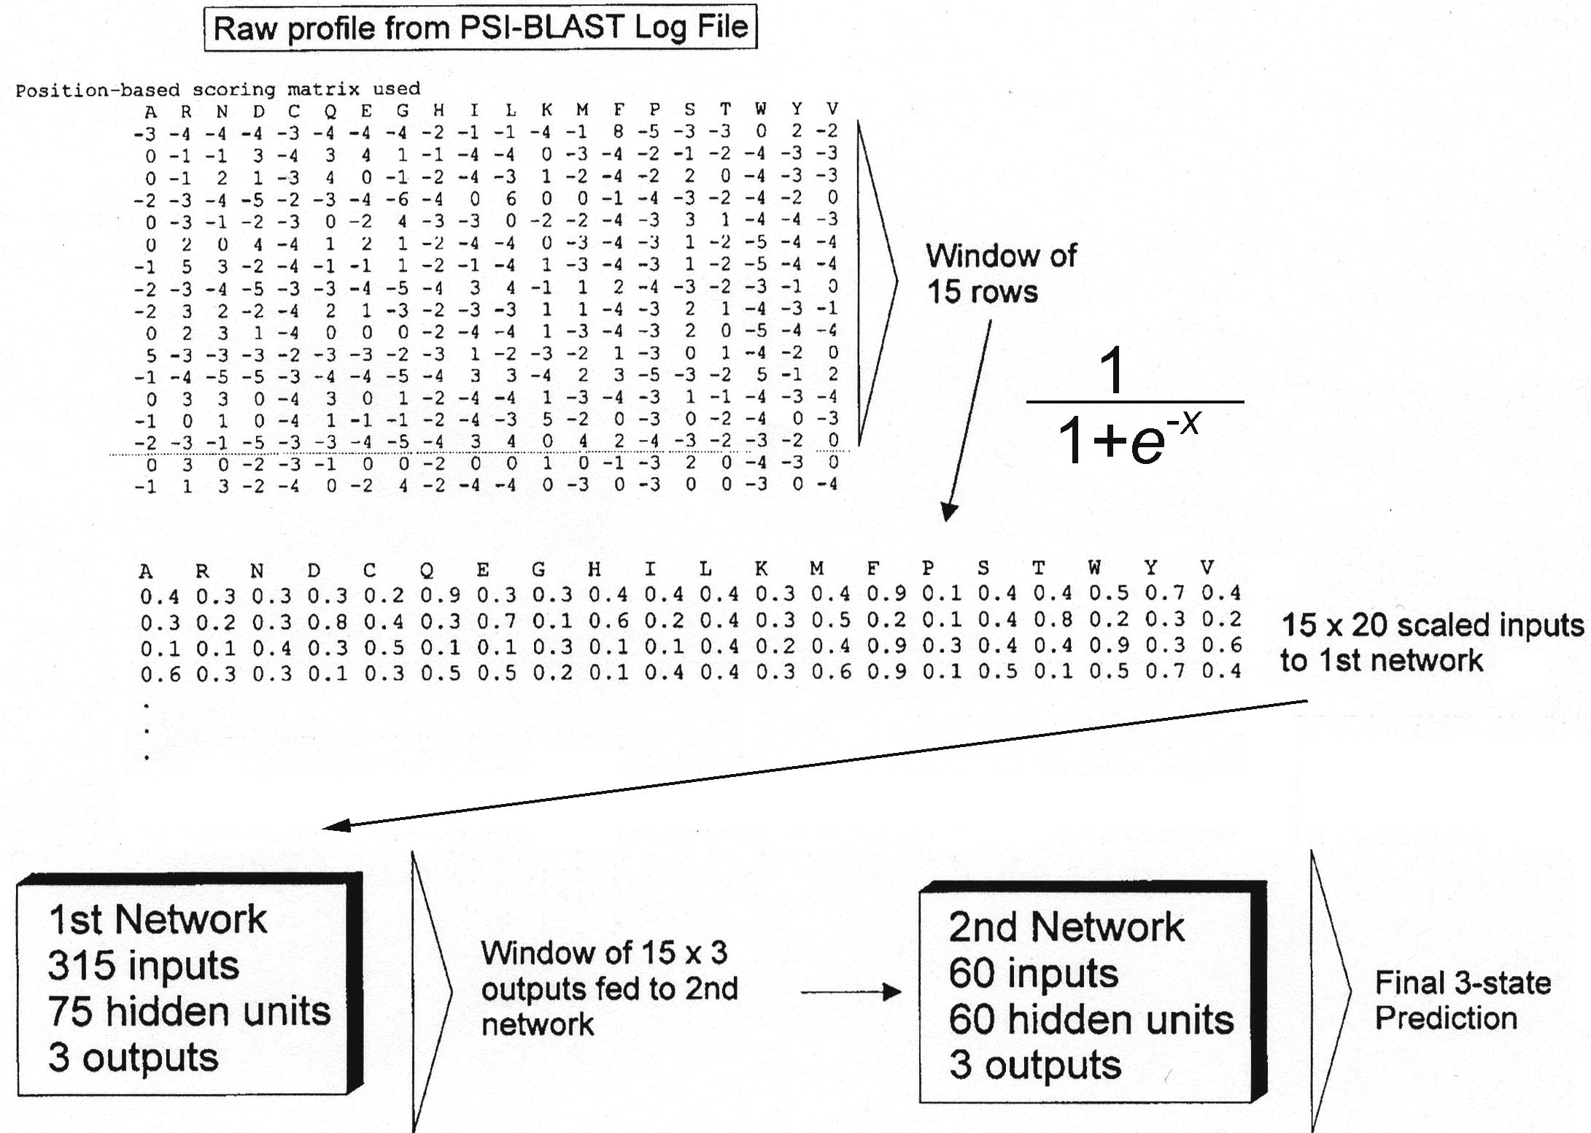
15 groups of 21 units
(1 unit for each aa plus
one specifying the end)
Filtering network
three outputs are helix, strand or coil

Slide 8
Neural Networks
The computer version of the neural network involves
identification of a set of inputs - amino acids in the
sequence, which transmit through a network of
connections.
At each layer, inputs are numerically weighted and the combined result passed to the next layer.
Ultimately a final output, a decision, helix, sheet or
coil, is produced.

Slide 9
Method
1st Network
Input Layer
Hidden Layer
Output Layer
Helix
Strand
15 groups
2nd Network
Coil
N-terminus
or
C-terminus
75 hidden units
315 input units
3 Output units
90% of training set was used (known structures)
10% was used to evaluate the performance of the neural
network during the training session.

Slide 10
Method
2nd Network
Input Layer
Hidden Layer
Output Layer
Helix
Strand
15 groups
Coil
60 hidden units
60 input units
3 Output units

Slide 11

Method
Training and Testing:
Class, C-level
Architecture, A-level
Topology (Fold family), T-level
Homologous Superfamily, H-level
187 protein chains
The reference secondary structure
States for each structure were
produced by DSSP.
H, E, I, G, B, S, T , -
62 chains
62 chains
63 chains
H
E
C
Three-way cross-validation

Slide 12
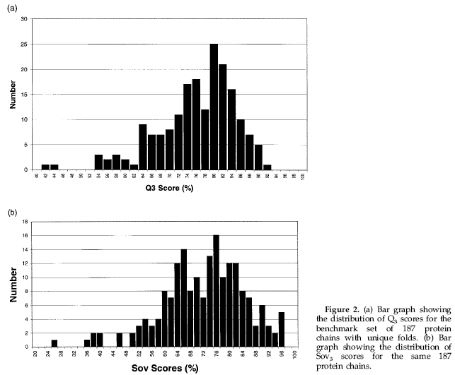
Results
By chain, the average Q₃ score was 76.0% with a standard deviation of 7.8 %. The average Sov score was 73.5% with a standard deviation of 12.7 %.
By residue, the average Q₃ score was 78.3%

Slide 13
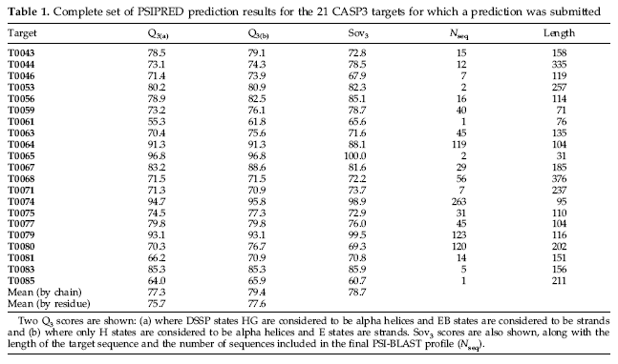
Results

Slide 14
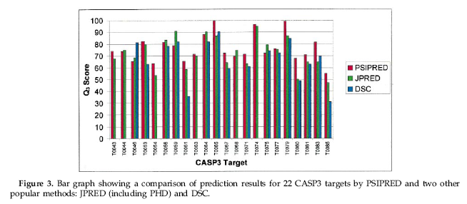
Results
The average Q₃ scores for the three methods over these targets are 76.3% (PSIPRED), 72.4% (JPRED) and 67.3% (DSC over 16 targets).

Slide 15
Example of Output from PSIPRED
PSIPRED PREDICTION RESULTS
Key
Conf: Confidence (0=low, 9=high)
Pred: Predicted secondary structure (H=helix, E=strand, C=coil)
AA: Target sequence
Conf: 923788850068899998538983213555268822788714786424388875156215
Pred: CCEEEEEEEHHHHHHHHHHCCCCCCHHHHHHCCCCCEEEEECCCCCCHHHHHHHCCCCCC
AA: KDIQLLNVSYDPTRELYEQYNKAFSAHWKQETGDNVVIDQSHGSQGKQATSSVINGIEAD
10 20 30 40 50 60

